Slide 1
Privacy-preserving data publishing
Paper presenter: Erik Wang
Discussion leader: XiaoXiao Ma

Slide 2
Overview
Research background
Paper go through
Key Technical
Anonymization
Information Loss Metric
Privacy Models
Conclusions

Slide 3
Research background
Objective
To handle data privacy issue when publishing data, sensitive data should not be disclosed.
Solution
Try to modify data so that to avoid adversary to analyses the published data by apply his background knowledge to get sensitive information
Notes:
Not a passive data leak but initiative

Slide 4
Overview
Research background
Paper go through
Key Technical
Anonymization
Information Loss Metric
Privacy Models
Conclusions

Slide 5
Paper go through
This paper is the first 2 chapter of the book
Privacy-preserving data publishing an overview. Published in 2010
How does the data owner modify the data?
How does the data owner guarantee that the modified data contain no sensitive information?
How much does the data need to be modiﬁed so that no sensitive information remains?
Chapter 1: Background of the research
Chapter 2: Concepts
Technique – Anonymization
Metric – information loss metric
Model – Privacy models

Slide 6
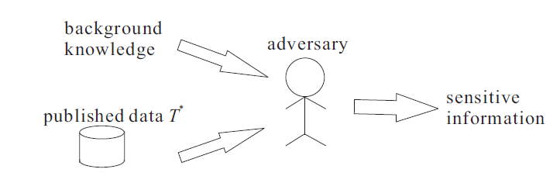
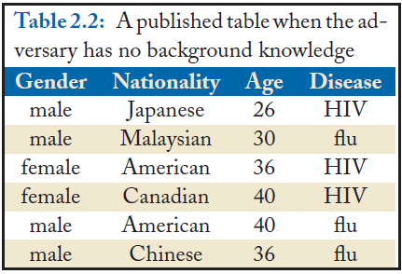
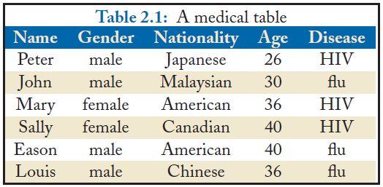
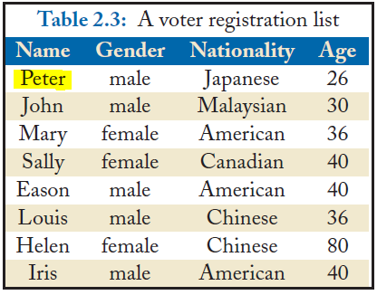
Identify the problem
Notes:
No law, and ethic

Slide 7
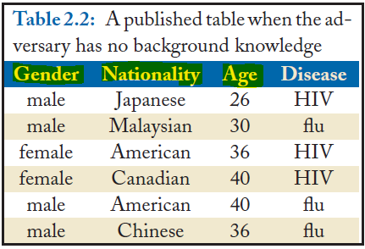
Concepts
Sensitive (data, value, tuple, attribute…)
Something will offend privacy – not happy to share others
Qusai-identifier (a.k.a QI)
Quasi-identiﬁer attributes are those that can serve as an identiﬁer for an individual.

Slide 8
Overview
Research background
Paper go through
Key Technical
Anonymization
Information Loss Metric
Privacy Models
Conclusions

Slide 9
Anonymization
Grouping-and-breaking
Break exact linkage between QI value and sensitive value
Perturbation
Change / generate to fake value

Slide 10
Grouping-and-breaking
Suppression
Change value to ANY, denoted by *
Generalization
Change to another categorical value to denoting a broader concept of the original one
Global and local recording – how deep we do generalization
Bucketization (breaking)
Divide data into partitions, hidden sensitive data with ID, and generate sensitive table which connect with main table by ID

Slide 11
Grouping-and-breaking
Method | Advantage | Drawback
Suppression | Easy to use Perfect to hidden data | OVERKILL
Generalization | Change value to more generalized one i.e. numeric to a range, categorical value to boarder concept | Extra work to maintain taxonomy Lost original actual value
Global recording | Consistent represent anonymized table | More information loss
Local recording | Table generated by local recoding is more similar to the original table, and thus the data analysis based on this table is more accurate. | cannot give as consistent a representation of the anonymized table as global recoding
Bucketization | Allowing users to obtain the original speciﬁc values for data analysis. | Need extra table requires some sophisticated analysis of the data generated by bucketization

Slide 12
Perturbation
Adding Noise
applicable to numeric attributes.
If the original numeric value is v, adding noise will change the value to v +∆ by adding a value ∆ that follows some distribution.
Swapping
Swapping the two values (of the same attribute) of any two tuples in the dataset.
Mode-fitting-and-regenerating
Modeling – parameter estimation – data regeneration
i.e. condensation:
Clustering data, find center, radius and size, and then regenerate new data according to the cluster

Slide 13
Perturbation
Method | Advantage | Drawback
Add noise | it maintains some statistical information such as means and correlations | may introduce some values that do not exist in the real world.
Swapping | the domain of each single attribute after value swapping remains unchanged. | combination of the swapped value of this attribute and the values of other attributes may not exist in one of these two tuples
regeneration | the statistics of the data captured by the model are maintained. | it may generate some tuples that may not exist in real data.

Slide 14
Overview
Research background
Paper go through
Key Technical
Anonymization
Information Loss Metric
Privacy Models
Conclusions

Slide 15
Information loss metric
The cost of anonymization is given by the distortion ratio of the resulting data set.
Value of the attribute of a tuple been generalized, there will be distortion.
Let d_{i,j} be the distortion of the value of attribute A_{i}
of tuple t_{j}
The distortion of the whole data set distortion dis = ∑_{i,j} d_{i,j}
Distortion ratio is disdataset / disfull_generatlized

Slide 16
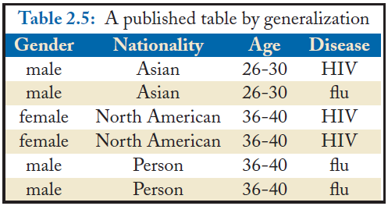
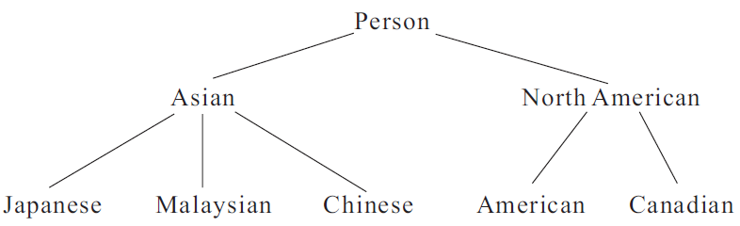
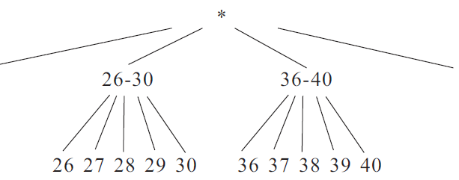
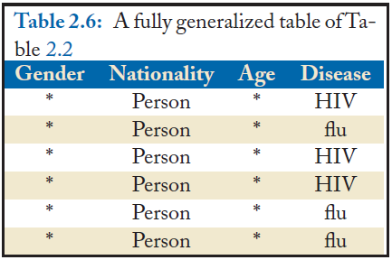
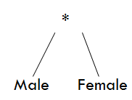
Information loss metric
Distortion = 4 +3 =7
Distortion ration = 7 / 18 = 38.89%
Distortion = 3 * 6 = 18
Notes:
alter

Slide 17
Overview
Research background
Paper go through
Key Technical
Anonymization
Information Loss Metric
Privacy Models
Conclusions

Slide 18
Privacy models: k-anonymity
k- anonymity
The size of the QI-group is at least k.
A table T is said to satisfy k-anonymity (or a table is said to be k-anonymous) if each QI-group satisﬁes k-anonymity.
The objective of k-anonymity is to make sure that each individual is indistinguishable from at least k − 1 other individuals in the table.
Sensitive attributes are not protected!
2 - anonymity
Notes:
QI group female – NA – 36-40 – HIV is not protected, if adversary knows the QI group, he can deduct all people in it has aids

Slide 19
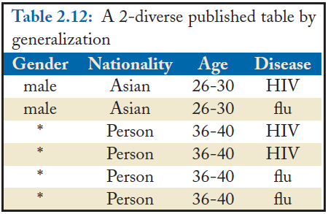
Privacy models: l-diversity
l – Diversity
The probability that any tuple in this group is linked to a sensitive value is at most 1/l.
The table satisﬁes l-diversity if each QI-group satisﬁes l-diversity.
P = ½ = 1/ l → l = 2
P = 2/4 = 1/ l → l = 2
2-diversity table
Notes:
1 – diversity is meaningless

Slide 20
Privacy models: (a,k) anonymity
Given a real number α ∈[0, 1] and a positive integer k.
QI-group G is said to satisfy (α, k)-anonymity if the number of tuples in G is at least k and the frequency (in fraction) of each sensitive value in G is at most α.
If α = 1/l, it is a simplified l-diversity model
(0.5, 2)-anonymity table

Slide 21
Privacy models: monotonicity
Monotonicity:
Let R be a privacy model. R is said to satisfy the monotonicity property if, for any two QI-groups G1 and G2 satisfying R, the ﬁnal QI-group that is a result of merging all tuples in G1 and all tuples in G2 satisﬁes R
Model | Monotonicity
2-diversity table | √
(0.5, 2)-anonymity table | √

Slide 22
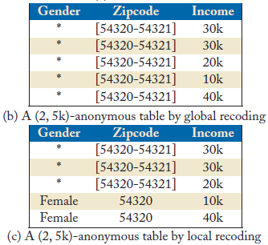
Privacy models: numeric sensitive attributes
Straight-forward: Transformed numeric attribute is to a categorical one, then be anonymized leads information loss.
(k,e) – anonymity model
each QI-group is of size at least k and has a range of the sensitive values at least e.

Slide 23
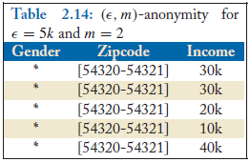
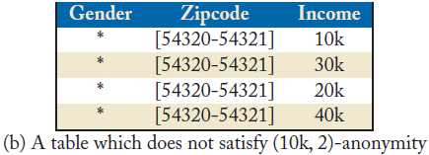
Privacy models: (Є, m) – anonymity
Є is a non-negative real number and m is a positive integer.
Each QI-group G satisfy for each sensitive numeric value that appears in G, the frequency (in fraction) of the tuples with sensitive numeric values close to s is at most 1/m where the closeness among numeric sensitive values is captured by parameter Є.
Absolute difference, a numeric value s1 is close to s2 if |s1 − s2| ≤ Є
Relative difference , a numeric value s1 is close to s2 if |s1 − s2|≤ Є s2
Does not obey the monotonicity property
¾ > ½

Slide 24
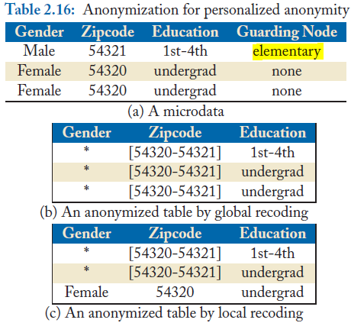
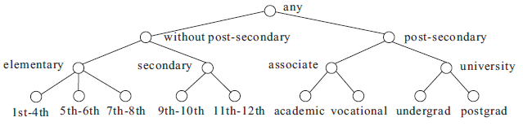
Privacy models: personalized privacy
Each individual can provide his/her preference on the protection of his/her sensitive value, denoted by a guarding node.
Any QI-group in the published table that may contain the individual should contain at most 1/l tuples with guarding values
A variation of l-diversity so that it satisfies monotonicity property
Notes:
Taxonomy

Slide 25
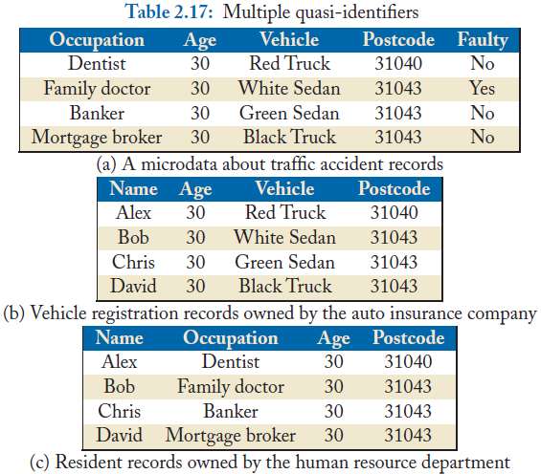
Privacy models: Multiple QI attributes
Extend the possibility of QI attribute from one external source to multiple source
The model satisfies monotonicity property

Slide 26
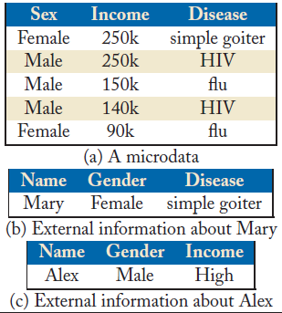
Privacy models: Free-form anonymity
Proposed based on whether a value is easily observable. If a value is easily observed, it is assumed that it is non-sensitive and is regarded as a quasi-identifier. Otherwise, it is regarded as a sensitive value.
Add a condition to the definition
of “Sensitive”

Slide 27
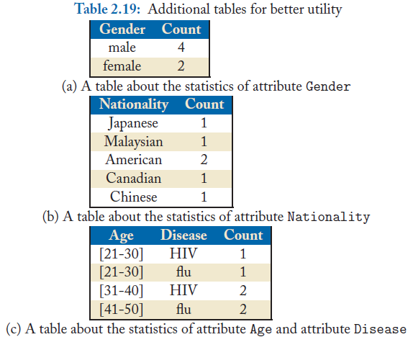
Publishing additional tables
publish some additional tables that are not sensitive at all so that these tables together can provide better utility
Notes:
You know there are additional male but can’t determine which 2 are they

Slide 28
Conclusion
Fundamental concepts that underlie all approaches to privacy preserving data publishing.
How to modify the data (suppression, generalization, bucketization and perturbation)
Minimizing the information loss of the modified data by using privacy model.

Slide 29
Questions and Discussion

